Slide 1
Project 1
Chang Yu
Nestor Pardo
Edrin Ngadze
Analysis of data science job salaries from 2020-2023
Notes:
Analysis of Data Science Job Salaries: 2020-2023
Subtitle: Unveiling Trends and Insights in the Data Science Job Market
As the demand for data-driven decision-making has surged, along with it the demand for data science professionals, we look at how this has this impacted their compensation?

Slide 2

Preliminary analysis
Data cleaning
.describe() output
The dataset contains 3006 entries
The average salary in USD is roughly $135,000 with an sd of around 63,000
Min salary is $5000 and max is $450,000(very broad sample)
Notes:
Methodology: We found a dataset with salary information anonymously from data science professionals all over the world. And this is what we will analyse for
Factors Influencing Salaries: Exploring variables like location, experience, and and the companies themselves.
The dataset contains 3006 entries. The average salary in USD is approximately 134,000, with a standard deviation of around 63,000. This indicates a significant variation in salaries.
The minimum salary is 5,000 USD, and the maximum is 450,000 USD(very Broad sample)

Slide 3
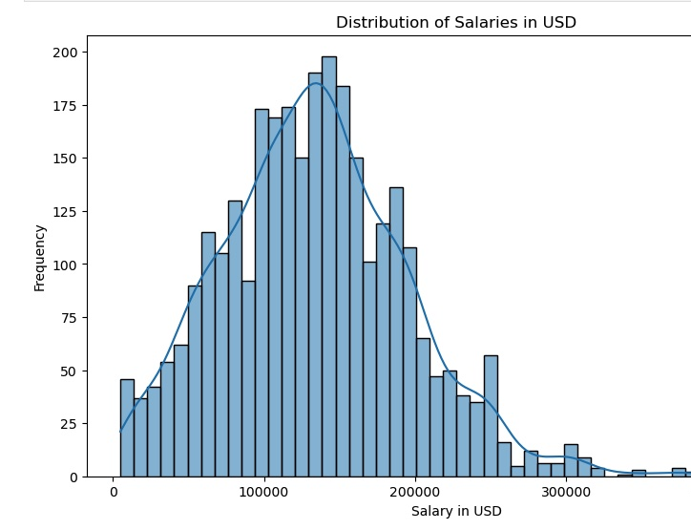
A Plot of the distribution of salaries approximates a bell curve
T-test to compare the mean salaries of 2 different groups yields a p-value of <0.05 suggesting there is significant difference in mean salaries
Notes:
And if we look at a plot of the distribution of salaries, we can see an almost normal distribution with a left skew which is expected as most companies prefer to pay their employees the smallest possible amount. Performed a t test on the mean salaries for data analyst and data engineer just as a guage for the statistical relevance We will attempt to investigate some factors impacting the spread of salaries

Slide 4

Questions for analysis
Examine how the type of employment in Data science(part-time, full-time, casual) influences salary
Analyze how the level of experience impacts salary.
Investigate the relationship between company size and salary.
Notes:
We boiled it down to 3 basic questions
Establish a relationship between employment type and salary:
Break down the salary distribution based on employment type in AI: part-time, full-time, and casual roles.
Then we looked at experience as a determining factor for salary
Analyze the influence of experience on salary: Does more experience always equate to a higher salary in the AI sector?
And lastly company size
Investigate if company size plays a role in determining

Slide 5
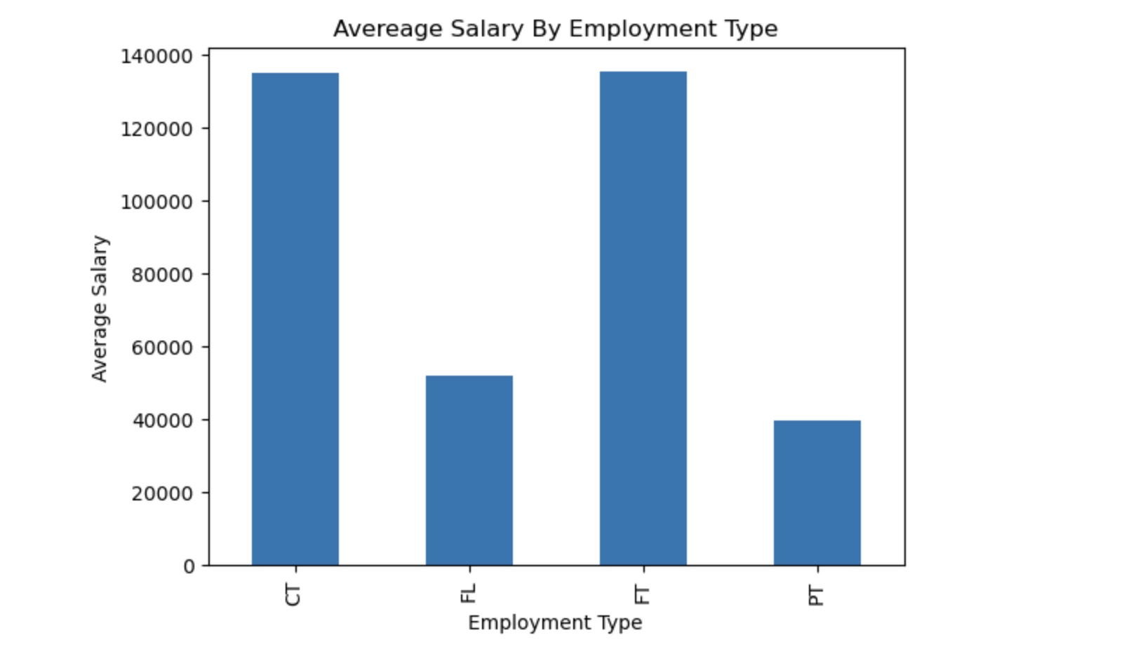
Salary distribution based on employment type in AI: part-time, full-time, and casual roles
Full time and contract workers have the highest average salary
Followed by freelance. Workers
Part time workers make the least
ANOVA test yields a P-value of 2.634955997528529e-09
Notes:
Here we see a basic bar plot for the 4 employment types represented in the data set
Full time workers and contractors make the most(in excess of $130k, followed by freelance 52k workers, part-timers make the least at 39.5k'''
For further analysis on impact of employment type on salary, we can look at the distribution of salaries within each employment type. This gives a better understanding of the salary range and any potential outliers within each group.
We did not correct for hours worked or work output as information on these factors was not present
P value less than 0.05

Slide 6
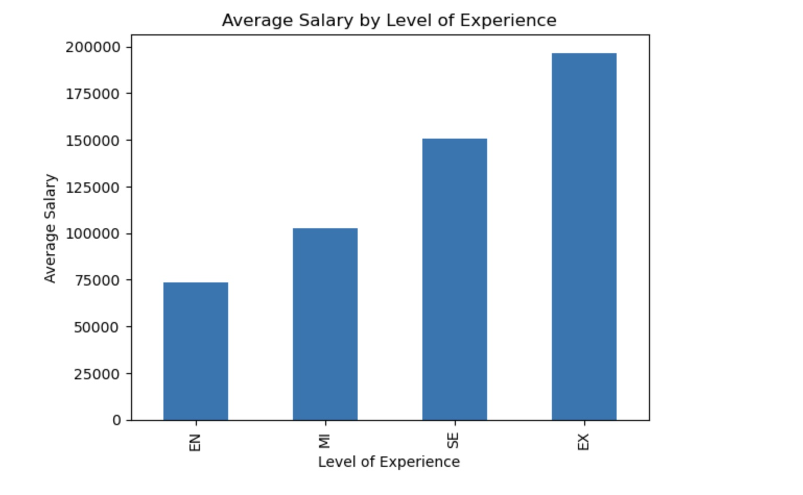
Does more experience always equate to a higher salary in the AI sector?
Experience does determine salary with the average salary going up with level of experience
Performed an ANOVA test and the P-value was 2.778469576950657e-137
Notes:
Next, I analysed the impact of experience level on salary. This could provide insights into how much experience contributes to the salary of an employee. I grouped the data by experience level and calculate the average salary for each group.
This shows the average salary for entry-level (EN), mid-level (MI), senior-level (SE), and executive-level (EX) employees. It appears that the average salary increases with the level of experience.
Again the ANOVA yields a P-value is less than 0.05, which suggests that there is a statistically significant difference in salary in USD between the different experience levels.

Slide 7
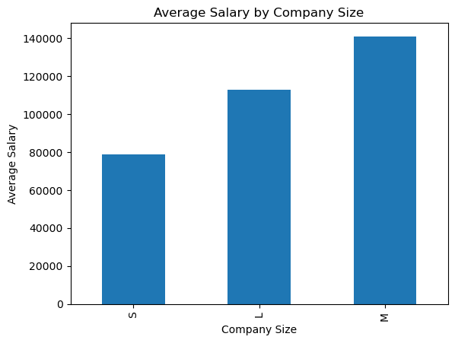
Does company size play a role in determining salary? Do larger companies pay more?
Mid sized companies have the highest average salary
Small size companies have the lowest
Notes:
Small-sized companies (S) pay an average salary of approximately $78,648.
Medium-sized companies (M) pay an average salary of approximately $140,863.
Large-sized companies (L) pay an average salary of approximately $112,821.
This indicates that the size of the company does have a significant impact on salary, with large companies paying the highest average salary in this dataset.

Slide 8
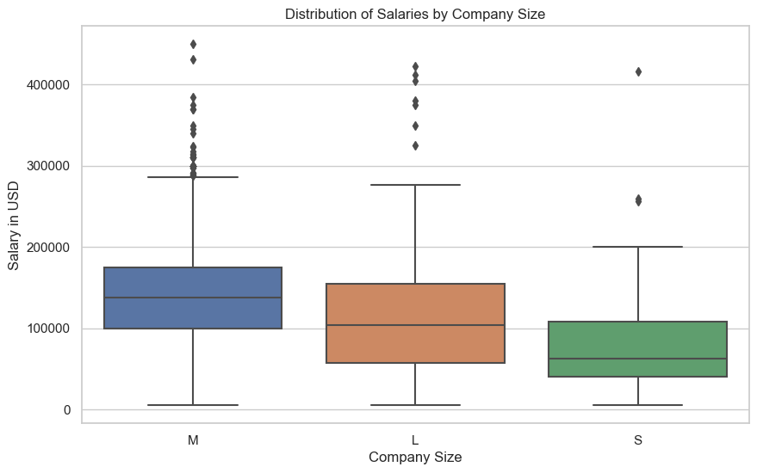
This plot provides a visual representation of the range and distribution of salaries for each company size
Medium and Large Companies have the large numbers of outlier values
Medium companies have the largest spread in values
Notes:
To further understand the data, I created a visualization showing the distribution of salaries across different company sizes. Just to give us a better understanding of the salary range and any potential outliers within each company size category

Slide 9
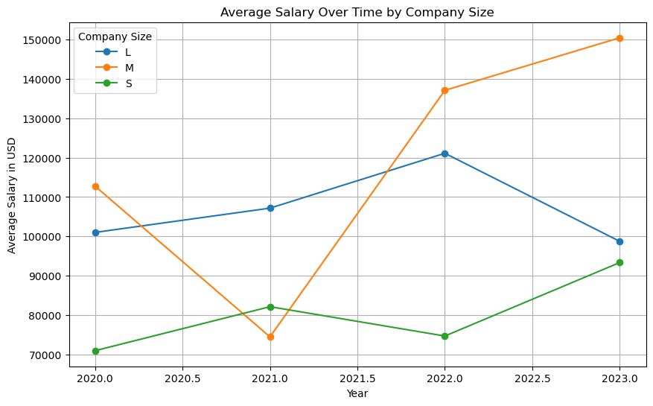
The biggest variation occurs in mid sized companies. Large companies show a general trend upwards then a drop from 2022-23 Small companies generally stay constant,
Notes:
Each line represents a different company size (L for large, M for medium, S for small). The x-axis represents the year, and the y-axis represents the average salary in USD. This graph provides a visual representation of how the average salary has changed over time for different company sizes.
Chang for the Job title analysis

Slide 10
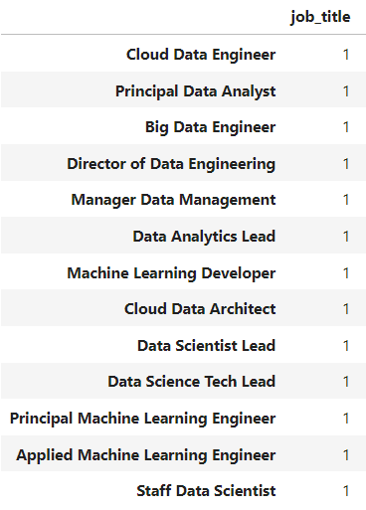
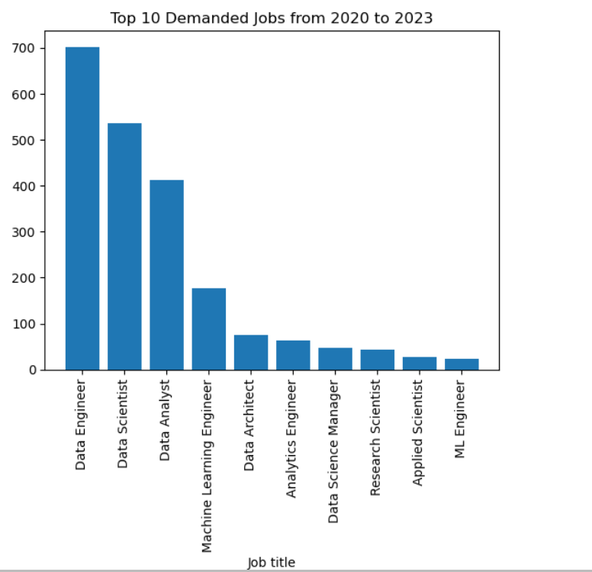
Top 10 demanded jobs and jobs in low demand (lack of data)

Slide 11
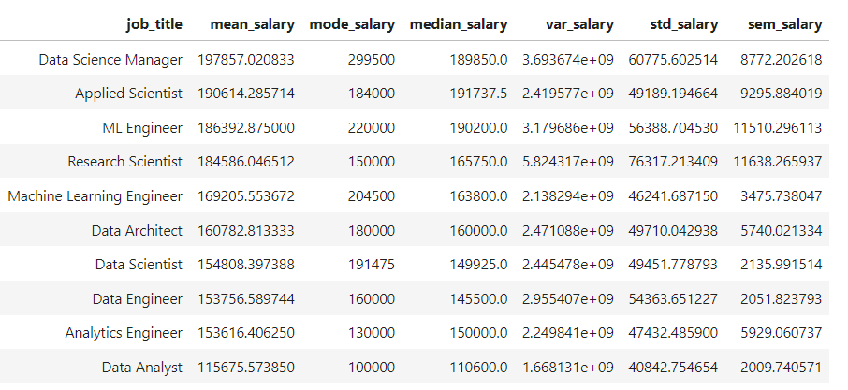
Salaries of top 10 jobs in demand

Slide 12
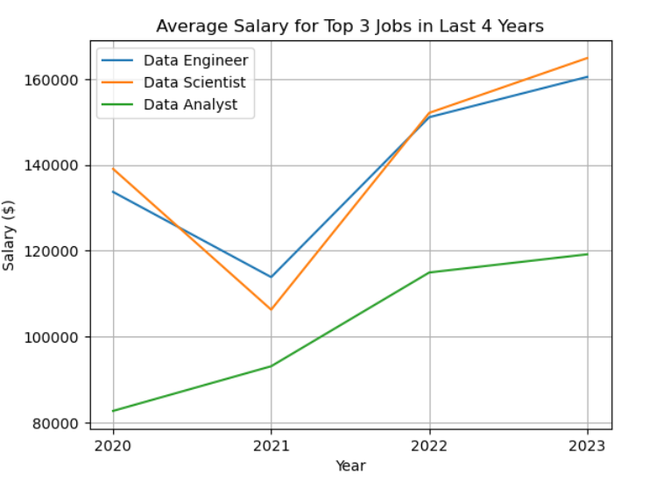
Change of average salary from 2020-2023
Trends of data engineer and data scientist are similar.
In 2021, the average salaries of data engineer and data scientist decreased. In contrast to data analyst.

Slide 13
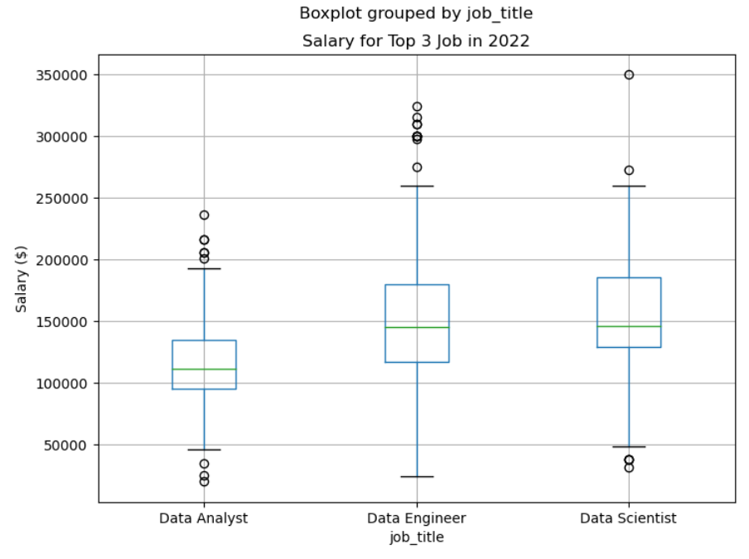
Compare salary for top 3 jobs in 2022
The most number of outliers - Data engineer and data analyst.
The shortest data range -individuals in the data analyst have more similar salary levels.
P value of Kruskal–Wallis one-way analysis: 1.30141231e-43

Slide 14
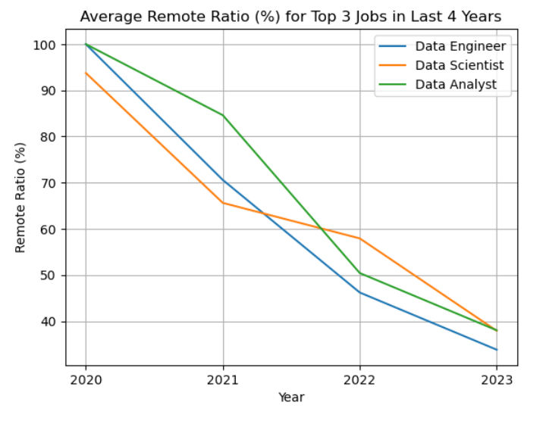
Remote ratio change with time
Remote ration decreases through the time.
However, the remote ratio of data analyst is the highest compared to others.

Slide 15
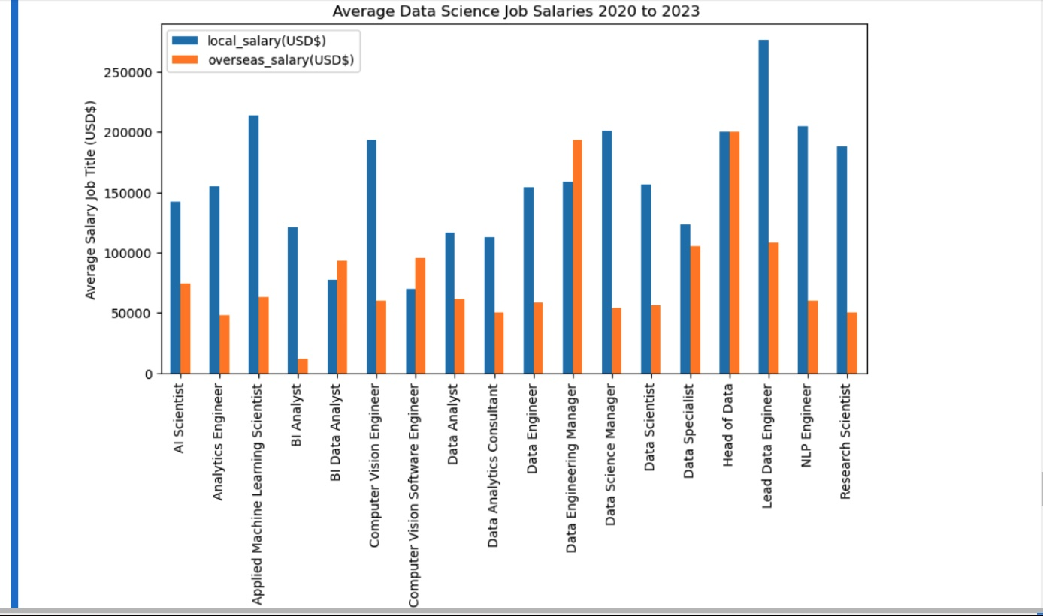
how does Remote job (overseas) affect job title, salary?
Most of the average salaries paid by local companies to overseas worker is lower than the salaries that they pay for local workers(2 exceptions)
There is higher pay for local workers
Companies can get the same kind of work done for less money from overseas

Slide 16
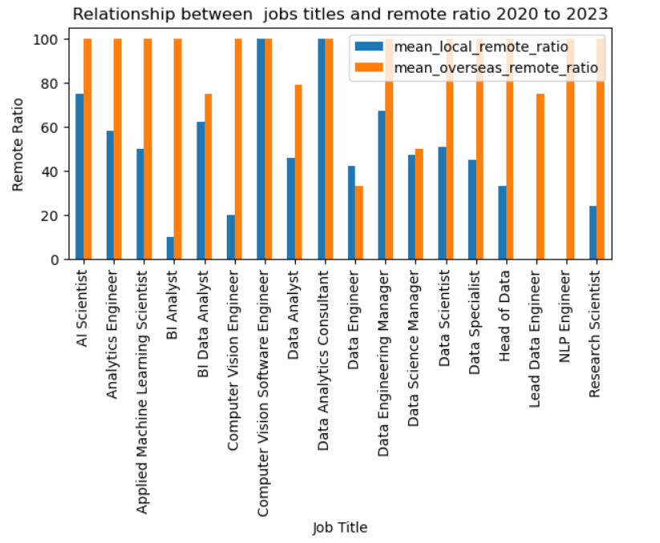
Relationship between job title and remote ratio 2023-23
Most of the job titles are full remote in comparison to the local job titles
Some of the local workers do not have the option to work remotely

Slide 17
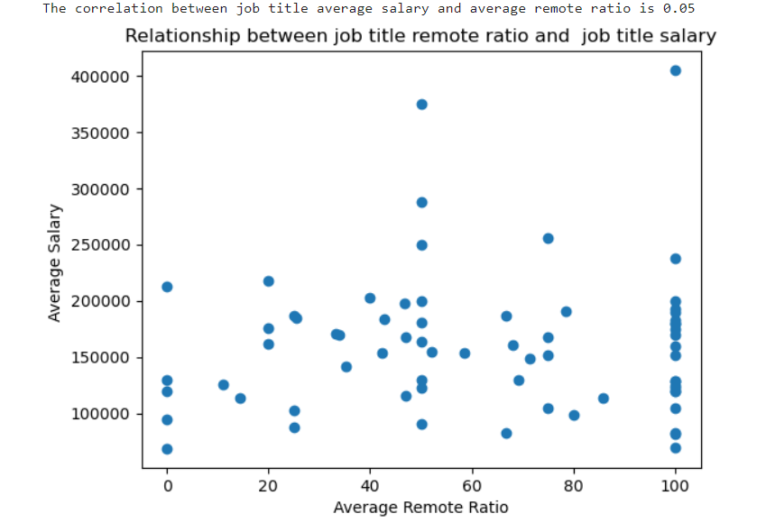
Relationship between average salaryand remote ratio

Slide 18

Questions ?

Slide 19

Thank you

Slide 20

Reference
Data Resource: Cedric Aubin (Mar 04 2023). AI/ML Salaries. Kaggle.com https://www.kaggle.com/datasets/cedricaubin/ai-ml-salaries

